Slide 1
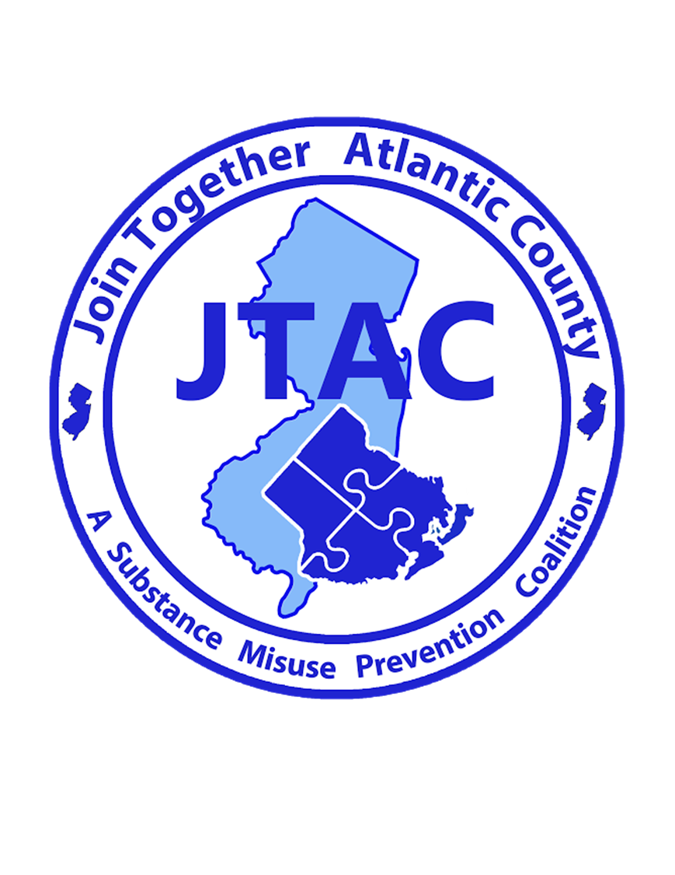
Join Together Atlantic County (JTAC)
A Substance Misuse Prevention Coalition

Slide 2
Welcome to
Join Together Atlantic County’s
Faith Based Meeting

Slide 3
Agenda
Introductions
Overview of Coalition
Interventions/Resources
Faith Based Initiatives – Website/Meetings/Trainings
Next Meeting
Coming together is a beginning; keeping together is progress; working together is success
-Henry Ford

Slide 4
Mission & Vision
JTAC’s mission is to prevent, reduce and/or delay substance use among youth of Atlantic County in a long term and sustainable manner.
Our vision is to partner with youth, parents, law enforcement, community leaders and citizens of this county and empower them to bring about the changes necessary to protect our youth, our families and our future
JTAC is funded through DFC, CARA and STOP-ACT grants from ONDCP, and 3 grants from NJ Department of Human Services Division of Mental Health and Addiction Services

Slide 5
Membership
JTAC has over 250 members from the following sectors:
Youth
Parents
Schools
Media
Law Enforcement
Civic and volunteer groups
Healthcare professionals
Business community
Youth serving organizations
Religious or fraternal organizations
State or local agencies with expertise in the field of substance misuse
Other organization involved in reducing substance misuse

Slide 6
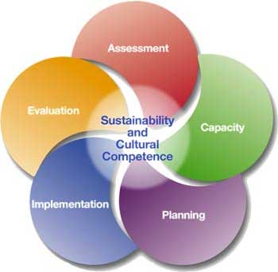
Strategic Prevention Framework

Slide 7
Needs Assessment
Policy Scans
Focus Groups
Key Informant Interviews
Prevention Resource Assessment
Community Readiness Surveys
Data Work Group (PRIDE Survey, ER Data, Poison Control Calls, Arrest Data, Treatment Data, YRBS, Overdose Rates)
JTAC utilizes environmental strategies to reduce underage drinking, marijuana use, and prescription medication misuse (link to heroin)

Slide 8
Prevention Strategies for Change
Provide Information
Build Skills
Provide Support
Enhance or Reduce Access & Barriers
Change Consequences
Change Physical Design
Modify Policy

Slide 9
Current Interventions Underage Drinking
Middle School PSA Contest/Billboard
Awareness for students concerning legal ramifications of underage drinking
Increase awareness of social host liability
Increase number and enforcement of Private Property ordinances and Nuisance Abatement ordinances
Model policies to reduce alcohol and other drug advertisements
Back to School Nights/Parents Events
Physician outreach
Model policies to reduce youth alcohol access at community events
We Check for 21 Conference
Conduct Responsible Beverage Server Trainings (TIPS), policies/ordinances
Sticker Shock Events
Cops in Shops Program
100% Proofing policies/ordinances

Slide 10
Current Interventions Marijuana
Create and distribute information that debunks marijuana as harmless
Social media campaign directed to local high school students on dangers of marijuana (ATI)
County-wide marijuana prevention event
Educate community on legal consequences of marijuana possession and driving under the influence
Encourage schools to collect data and update policies on marijuana use
Encourage police departments to collect data on marijuana use

Slide 11
Current Interventions Opioids
Safe disposal/disposal bags
Promote Take Back Days
Permanent prescription drop off boxes
Pharmacies distribute information on proper disposal
Mailing/workshop to realtors, funeral homes and hospices
Create/train School Resiliency Teams for youth who experience trauma
Resident removal
Distribute locking medicine cabinets
Advocate new construction/renovation projects to require prescription drug locking medicine cabinets
Promote parent education
Knock Out Opioid Abuse Day, 10/6
Treatment Resource Guides
Opiate Task Force

Slide 12
Current Interventions Opioid Task Force
Physician/EMT/Nursing Symposiums
Overdose prevention card for 1st responders
Increase collaboration among all agencies in county with programs and initiatives pertaining to opiates
Educate police officers about addiction and current issues
Availability of Naloxone within community organizations
Reduce misuse of opiates among youth athletes
Opiate awareness media campaign/website
Educate school staff/counselors about early warning signs, addiction and current issues
Do No Harm Symposium- Enhance skills of clergy/faith based organizations to recognize and understand addiction and substance use

Slide 13
Current Interventions Non-Drug Specific
Utilize ONDCP Drugged Driving Toolkit during National Impaired Driver Prevention Month
Update school drug policies
Youth treatment availability/barriers, linking youth to services when violations occur for ATOD (school, station house adjustments) Juvenile drug court
Youth AA/NA meetings (support groups) welcoming and convenient for youth
Recovery Month activities
Model policies/ordinances for motels/hotels, municipalities discouraging teen parties
JTAC Facebook page and website
Train coalition members on environmental strategies, media outlets, new drug trends etc.
Above the Influence Campaign
Coordinate PRIDE Survey for 8th, 9th, and 11th graders
Substance use treatment resource guide for police departments, community, EMT’s, Faith-based organizations
Promote pre-prom parent workshops to local high schools tied to purchase of prom tickets

Slide 14
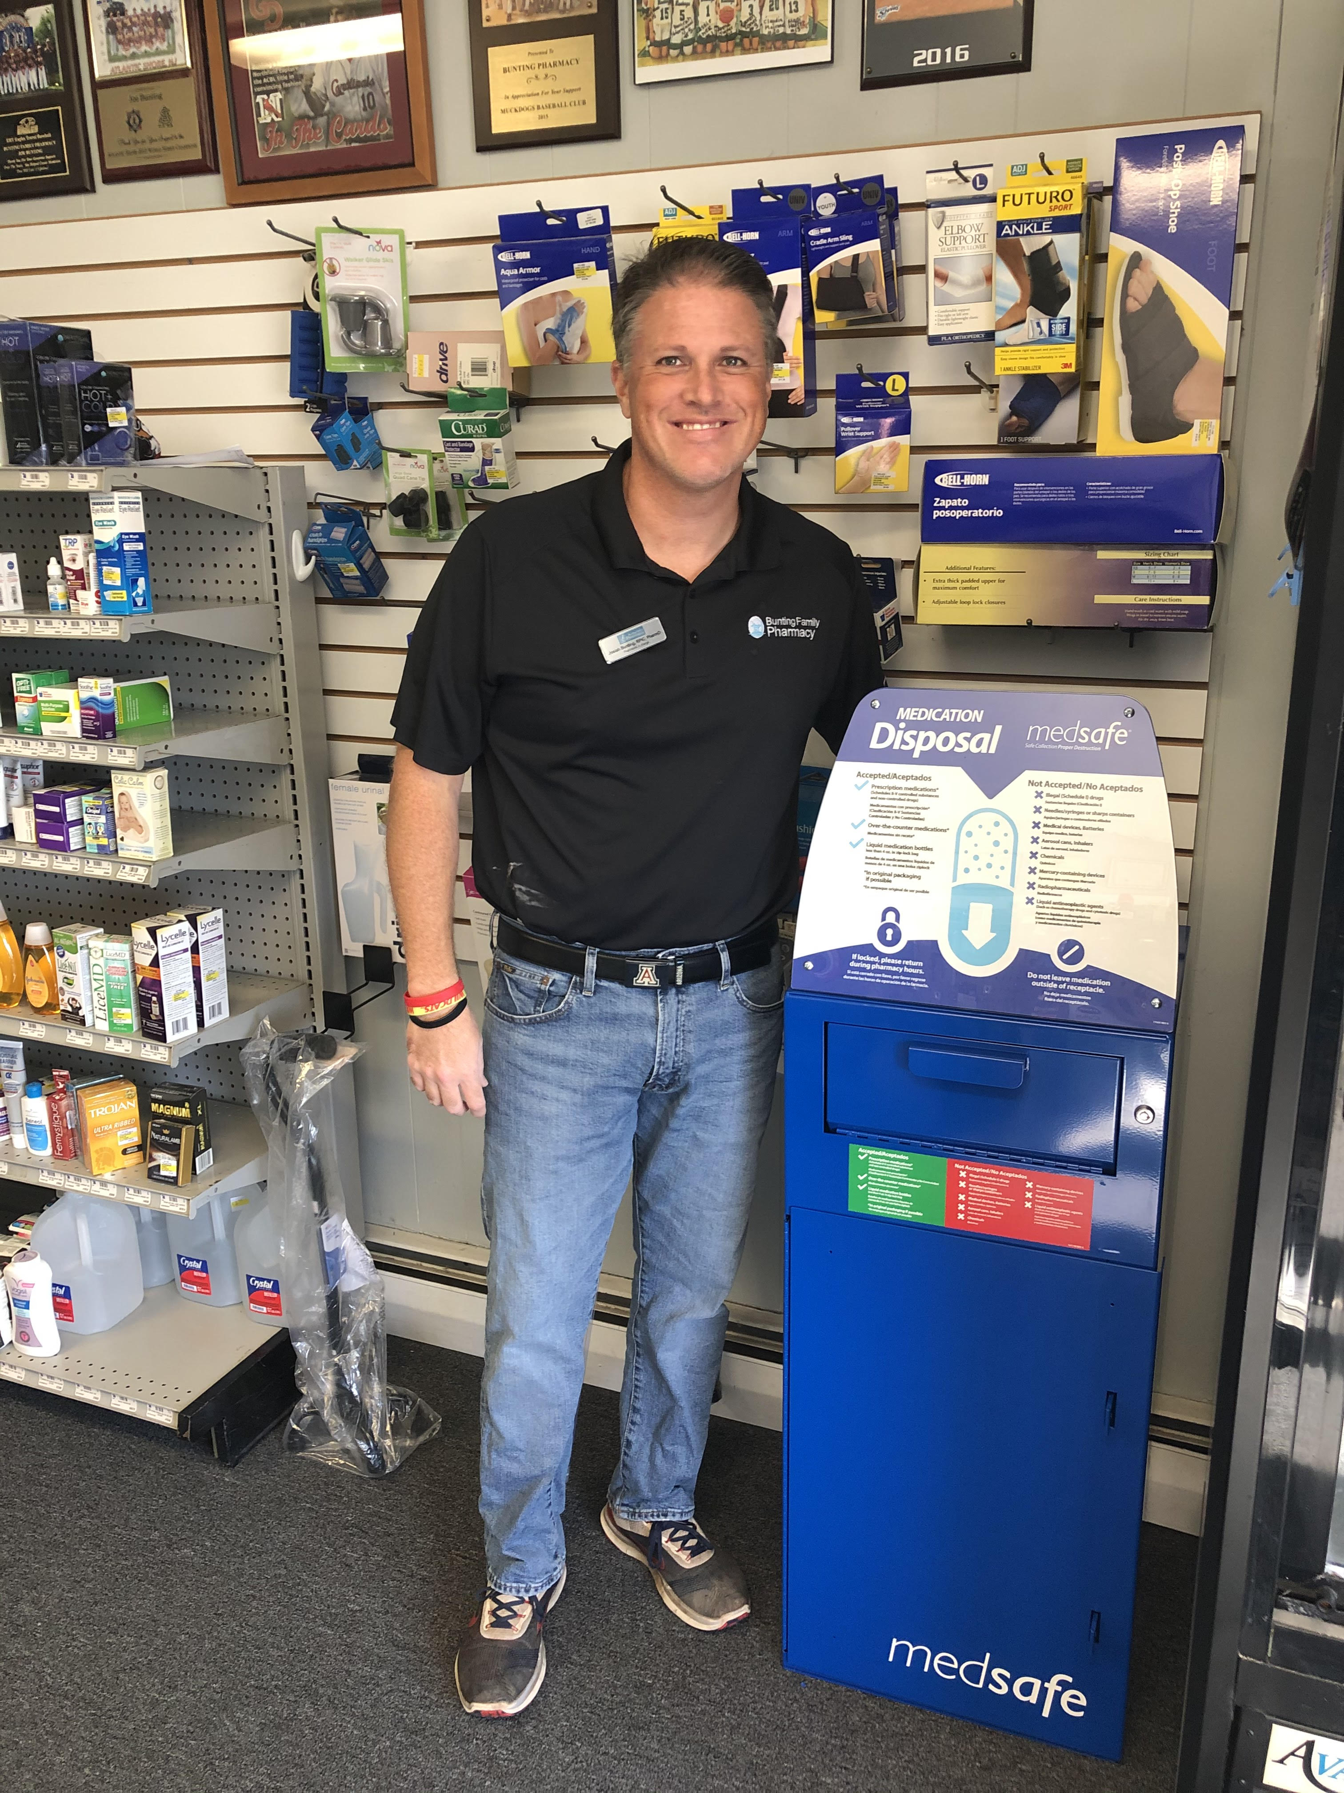
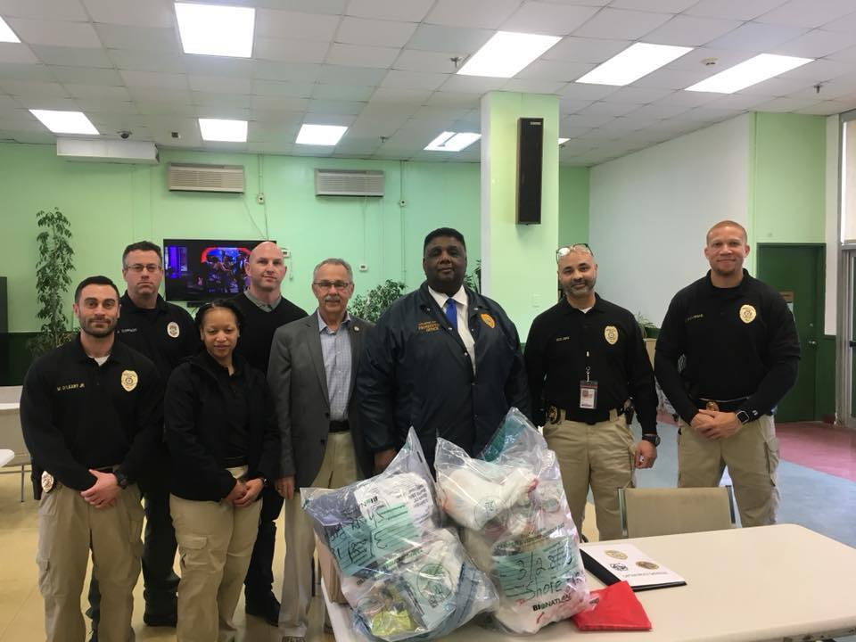
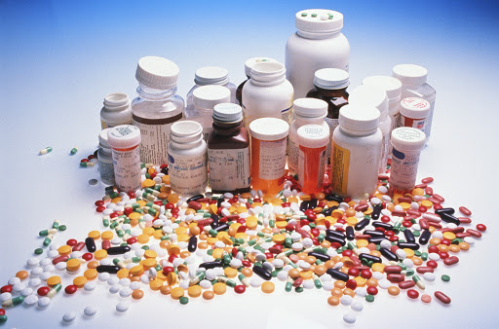
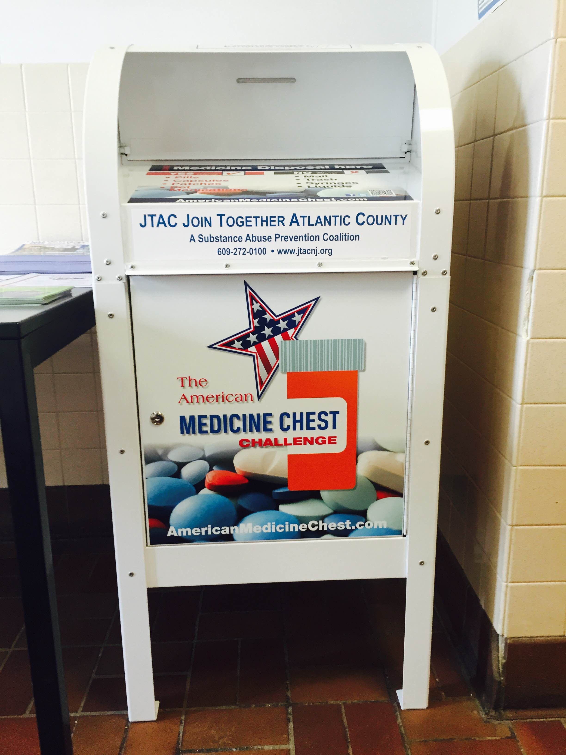
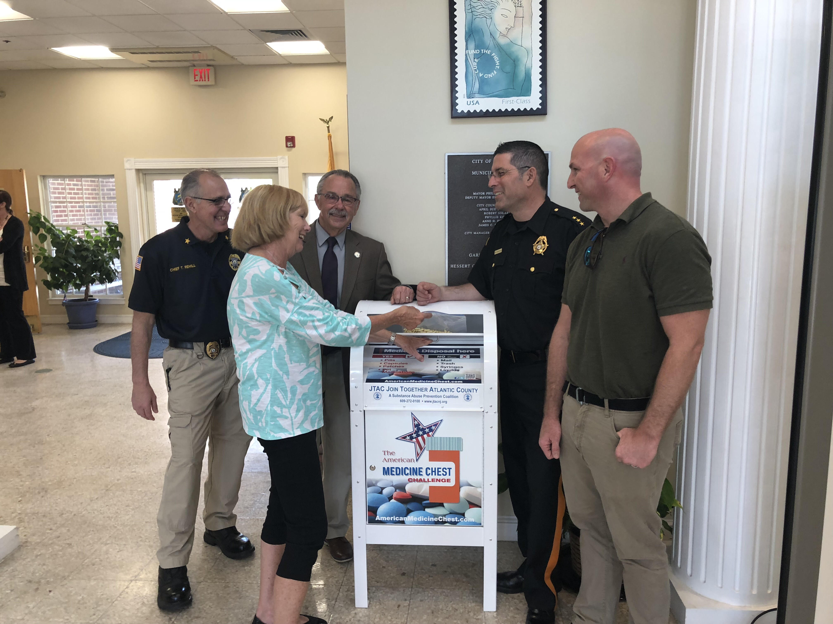
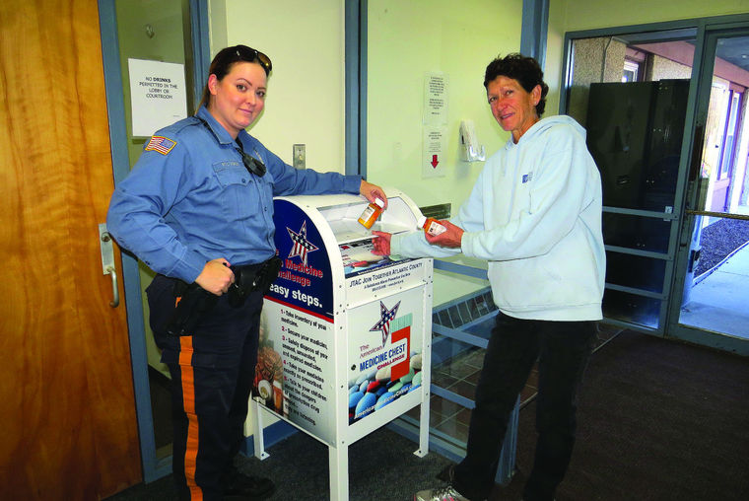

Slide 15
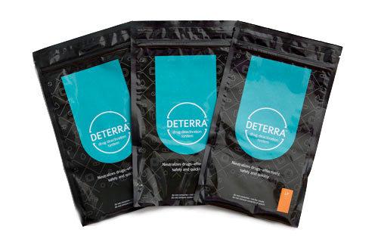
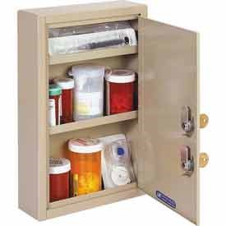

Slide 16
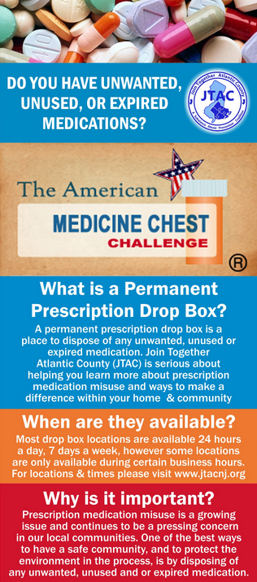
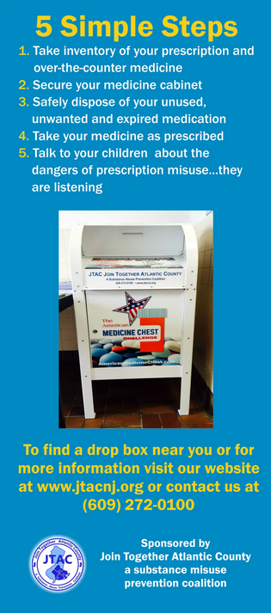

Slide 17
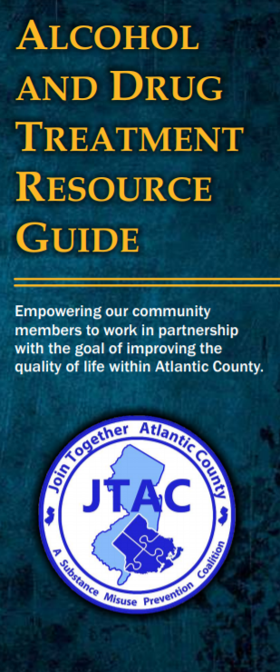
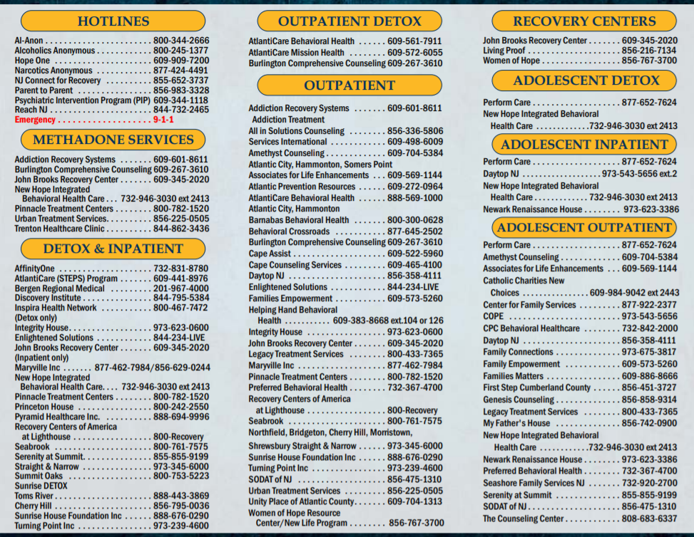

Slide 18
Contact Information:
Join Together Atlantic County
(609) 272-0101
JTACNJ@atlprev.org
www.JTACNJ.org
www.facebook.com/JTACNJ
Brian Wilson
bwilson@atlprev.org
Amber Cutano
acutano@atlprev.org
Atlantic Prevention Resources
626 N Shore Rd
Absecon NJ 08201
(609) 272-0101

